Slide 1
CS2303: Systems Programming Concepts
Class 1
Introduction
Copyright 2005-2017, Michael J. Ciaraldi
1

Slide 2
Today
Course intro
Historical Perspective
2

Slide 3
Course Intro
3

Slide 4
Course Intro
Introduction of the course staff
Text
Purpose of the course
Logistics
Policies
4

Slide 5
Course Staff
Instructor
Mike Ciaraldi
ciaraldi@wpi.edu
x5117
FL 129
http://www.cs.wpi.edu/~ciaraldi/
http://www.wpi.edu/~ciaraldi/
5

Slide 6
Course Staff
Teaching Assistant
Andad Ramakrishnan <aramakrishnan@WPI.EDU>
6

Slide 7
Course Staff
Senior Assistants
Aura Velarde Ramirez
<aivelarderamirez@WPI.EDU>
Augusto Wong
<arwong@WPI.EDU>
Axe Soota
<asoota@WPI.EDU>
Diana Doherty
<ddoherty2@WPI.EDU>
7

Slide 8
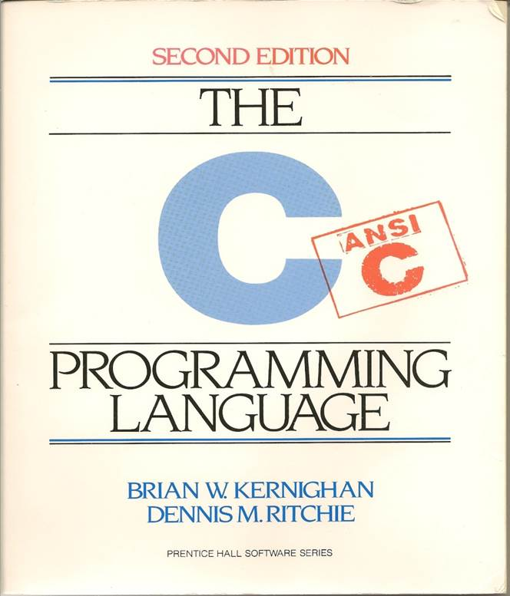
Official Text 1
Kernighan, Brian & Ritchie, Dennis, The C Programming Language, 2nd edition.
Look for the brown ring of quality.
8

Slide 9

Official Text 2
Walter Savitch, Absolute C++, 6th edition, Pearson/Prentice-Hall. 2015.
4th or 5th edition OK too.
MyProgrammingLab not needed.
9

Slide 10
Logistics: Lectures
Lecture:
FL-UPR, MTRF, 8:00-8:50 am.
This is a change, so we have plenty of space!
Exception:
No class on Monday, September 4 (Labor Day).
Final class: Thursday, October 12.

Slide 11
Logistics: Labs
In KH203 on Wednesdays.
Switching allowed!
Subject to space. Please check with TA.
Section | Day | Time
1 | Wednesday | 9:00-9:50 am
2 | Wednesday | 10:00-10:50 am
3 | Wednesday | 11:00-11:50 am
4 | Wednesday | Noon-12:50 pm
5 | Wednesday | 8:00-8:50 am

Slide 12
Weekly Quizzes
Typically on Thursdays at 8:00 pm.
But not today! ☺
Approximately 20 minutes.
You may start as soon as you arrive in the classroom.
If you normally take at the EPC:
See me about alternate locations, but be back in class by 8:20 am.

Slide 13
Weekly Quizzes
Closed book, open notes.
Notes only allowed on paper.
Class notes, plus anything you wrote yourself.
Not including old exams which you copied by hand.
No electronic devices!
Best five out of seven.
No make-up quizzes.

Slide 14
Final Tests
Final exam last day of class.
Counts as two quizzes.
Skip it to get an automatic NR.
Laboratory quiz final Wednesday.
Again, required to avoid NR.

Slide 15
Labs
Focus on using tools.
E.g., Eclipse, debugger.
Can do ahead or during lab section.
Upload to Canvas.
Due 11:59 pm Wednesdays.

Slide 16
Programming Homework Assignments
Probably 6 total
3 C, 3 C++
Upload to Canvas.
Due 6:00 pm Mondays.
Major penalties if you turn them in later or non-functional.
So turn in what you have working.

Slide 17
Grading
Quizzes ~45%.
Homework: ~45%.
Labs and subjective: ~10%.

Slide 18
E-mail
cs2303-staff@cs.wpi.edu
TAs, SAs, instructor
cs2303-all@cs.wpi.edu
Students and staff
Note: All lists are @cs.wpi.edu
18

Slide 19
Important E-mail Reminders
Include “CS2303” in the subject line.
Use a descriptive subject line.
In general, write to cs2303-staff@cs.wpi.edu, not just to me.

Slide 20
Assumed Background
Program design and construction.
Calculation, functions, control flow, documentation.
Object-Oriented Programming.
Java, Objects in a class hierarchy.
Basic Unix commands.
We will cover them.
20

Slide 21
Who Should Take This Course
Definitely CS Majors.
Also RBE and IMGD Tech.
Those who already know program design (and Java).
Those who want to do low-level, embedded, and/or systems programming.

Slide 22
Who Should Not Take This Course
Those who do not already know program design.
Beyond fooling around with VB.
Those who do not already know OO programming.
At least a little…
Take CS2301 instead if you want to learn C.
CS1004 is intro in Python.
CS2119 is Java for business.

Slide 23
Purposes of the Course I
Learn the C programming language.
And some C++.
Learn about different types of languages.
Learn low-level programming.
Learn more about good software design and programming practices.
23
Notes:
23
C++ is the enabler for the other purposes.

Slide 24
Purposes of the Course II
Learn some skills applicable to large-scale software projects.
Learn about data structures.
Prepare for Operating Systems and other upper-level courses.
24
Notes:
24

Slide 25
What This Course Won’t Cover
What a computer is.
Introduction to writing programs.
Introduction to designing programs.
Every aspect of C/C++.

Slide 26
Programming Paradigms
Functional
Functions consume data, produce data, have side effects, feed other functions.
Object-Oriented
Objects contain data and methods.
Methods can modify data in objects.

Slide 27
Programming Paradigms
Imperative
Data resides in variables (in memory).
Functions accept data as parameters, return data values, modify values in variables, and can have side effects.
This is much closer to how the hardware works.

Slide 28
Why C?
Available on almost any hardware/software platform.
Often the only language available.
E.g., embedded systems.
Supports low-level access.
Memory, I/O, bits, etc.
Has high-level constructs.
Runs efficiently.
Many libraries.

Slide 29
Why C++?
First broad-based OO language.
Every valid C program is automatically also a valid C++ program.
Still allows low-level access.

Slide 30
Course Topics
Comparison of Java, C, and C++
The procedural a.k.a. imperative programming paradigm
And some object-oriented
Program development and debugging
Variable scoping
Parameter passing
Memory management

Slide 31
Course Topics II
Error handling
Pointers!
Data Structures
The C Preprocessor
Bit manipulation
I/O
Modularity

Slide 32
What You Will Be Doing
Designing programs.
Writing programs.
Including complex ones spanning multiple files.
Debugging your programs.

Slide 33
Academic Honesty Policy
Don’t Cheat!
Do your own work.
Don’t take credit for someone else’s work.
OK to ask others for help.
The point of the course is for you to learn the content and develop the skills.
Merely reusing code that someone else wrote is usually not enough for an assignment.

Slide 34
Resources
The course Web site is on Canvas:
http://canvas.wpi.edu
Use Piazza for discussions.
You are responsible for the readings and for what is on these Web sites.

Slide 35
Virtual Machine
An application program capable of simulating a computer system with enough fidelity and performance to mimic actual computer hardware.
Everyone’s programs will be built and run in an identical environment.
In our case, Ubuntu 17.04 (I think).

Slide 36
Virtual Machine
Programs you write and run.
Guest OS (Ubuntu GNU/Linux)
We’ll refer to this as the VM.
VM Software (VirtualBox)
Host OS (MS Windows, MacOS, Linux)

Slide 37
Assignment #0
Download and install Oracle VirtualBox.
On your laptop.
Download and install the course virtual machine on your computing environment…
See document on Canvas (link on course home page).
Print it out!!
… and get it working RIGHT AWAY!!!

Slide 38
Assignment #0
Ask for help from
Any TA
Either professor
Anyone else who is willing.
Try it out with Lab #1 assignment
Already available on Canvas
At least Part 1!

Slide 39
No Laptop?
VirtualBox is already installed on all the Microsoft Windows machines in the public labs.
Obtain a USB flash drive.
At least 32 GB.
USB 3.0 is strongly recommended.
As fast as possible.
Install the course VM onto that drive.
Bring it to lab and office hours.

Slide 40
Reading Assignments for Next Time
Kernighan & Ritchie, Chapter 1
Absolute C++, Chapter 1

